Slide 1
Design Process
Source of most materials:
Xiwei Xu, Ingo Weber, and Mark Staples. Architecture for Blockchain Applications. Springer, 2019

Slide 2
What will you learn today?
Architecture design in general
Design process for blockchain-based systems

Slide 3
Architecture Design in General
Notes:
We discuss an indicative model for the design of systems that might use blockchain technology.

Slide 4
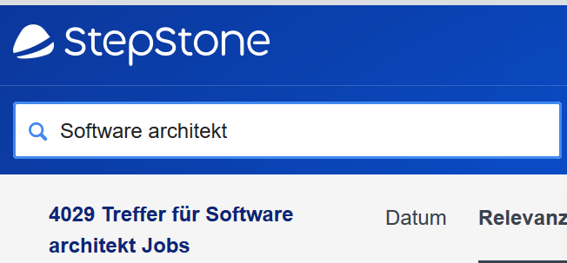

Every software system has a software architecture
“The set of structures needed to reason about the system, which comprises software elements, relations among them, and properties of both”
- “Documenting Software Architectures: Views and Beyond” (2nd Edition), Clements, Bachmann, and Bass, Addison-Wesley, 2010
Diagrams/ Documentation
Designing
(But not all design is architecture)
Discipline/ Practice/ Profession
Discovery (Research Area)
Starting in 1960s, increasing interest since 1990s

Slide 5
Architecture specifies component communication
Data passing mechanisms, e.g.:
Function call
Remote method invocation
Asynchronous message
Control flow
Flow of messages between components
Sequential
Concurrent/parallel
Synchronization

Slide 6

Why Non-Functional Properties Matter
Regulatory Requirements
System Performance
Market
Opportunities
New customers
New segments
New industries

Slide 7
Software Architecture
Non-Functional Properties arise from Architectural Design Choices
Choose your design,
Choose your trade-offs

Slide 8
Architecture is an Abstraction
Architecture provides an abstract view of a design
Hides complexity of design
May or may not be a direct mapping between architecture elements and software elements
c.f. “marketecture”
“All models are wrong, but some models are useful”
- George Box
Discussion: Why Abstraction?
Models are abstractions; what to model and what to abstract depends on the purpose
“[A] model which took account of all the variegation of reality would be of no more use than a map at the scale of one to one” - Joan Robinson, 1962

Slide 9


Viewpoints and Views

Slide 10
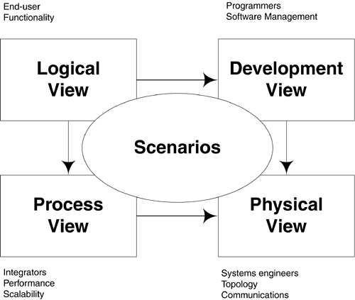
Krutchen’s 4+1 View Model
Logical: architecturally-significant elements and the relationships between them.
Process: concurrency and communications elements
Physical: how the major processes and components are mapped to applications hardware
Development: internal organization of the software components as held in e.g. a configuration management tool
Use cases: requirements for the architecture; related to more than one particular view

Slide 11
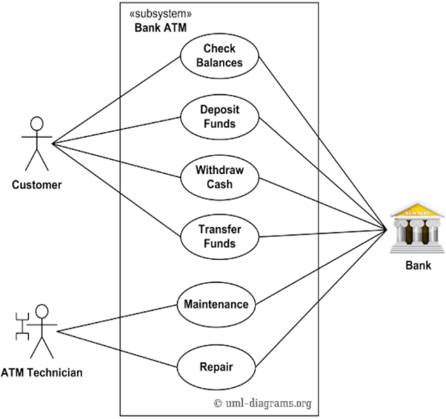
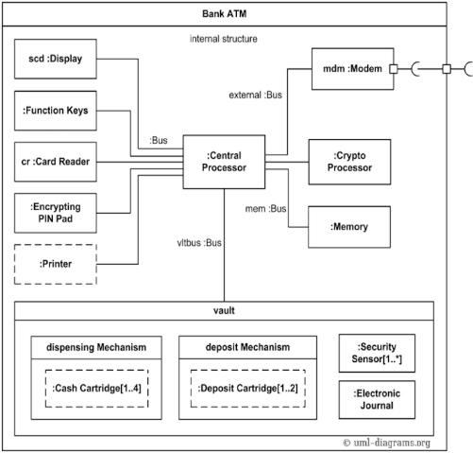
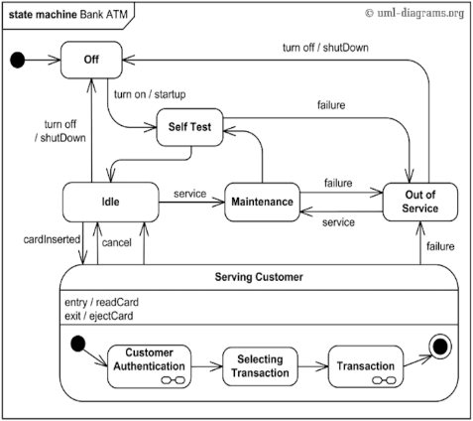
UML as Viewpoints and Views
UML Statechart
UML Composite Structure
UML Use Case
Notes:
Different diagrams to describe system from different views.
The software architecture of a program or computing system is the structure or structures of the system
Comprise software elements, the externally visible properties of those elements, and the relationships among them.
Software architecture is the earliest model of the whole software system created along the software lifecycle

Slide 12

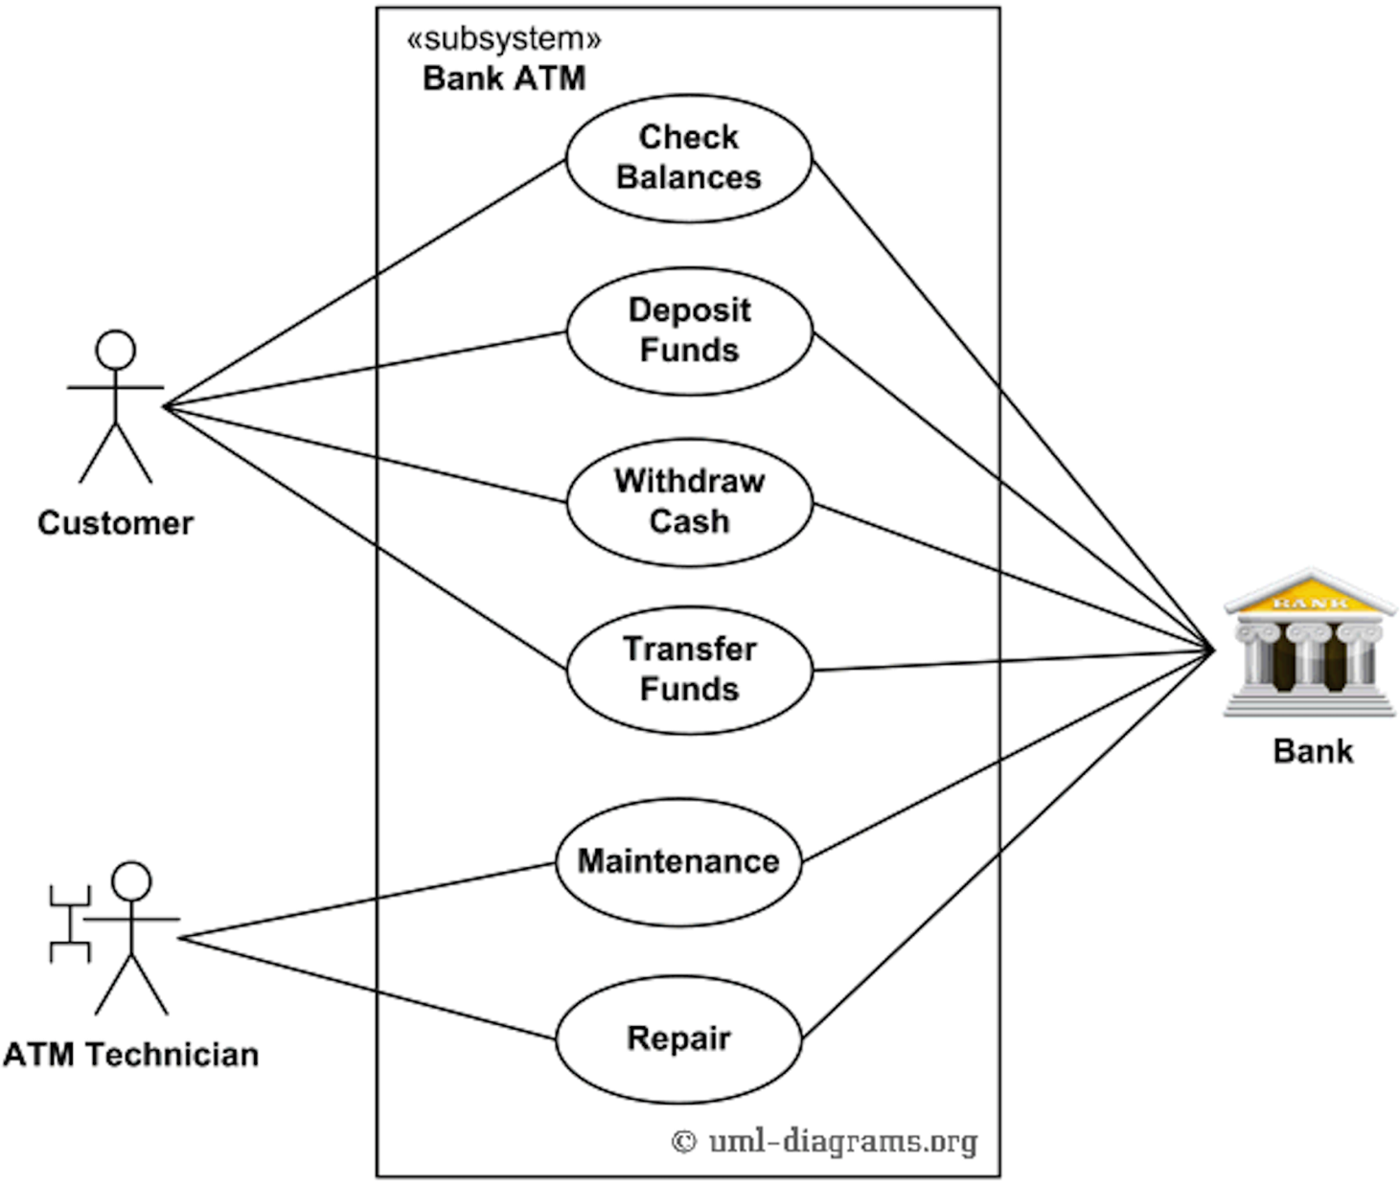
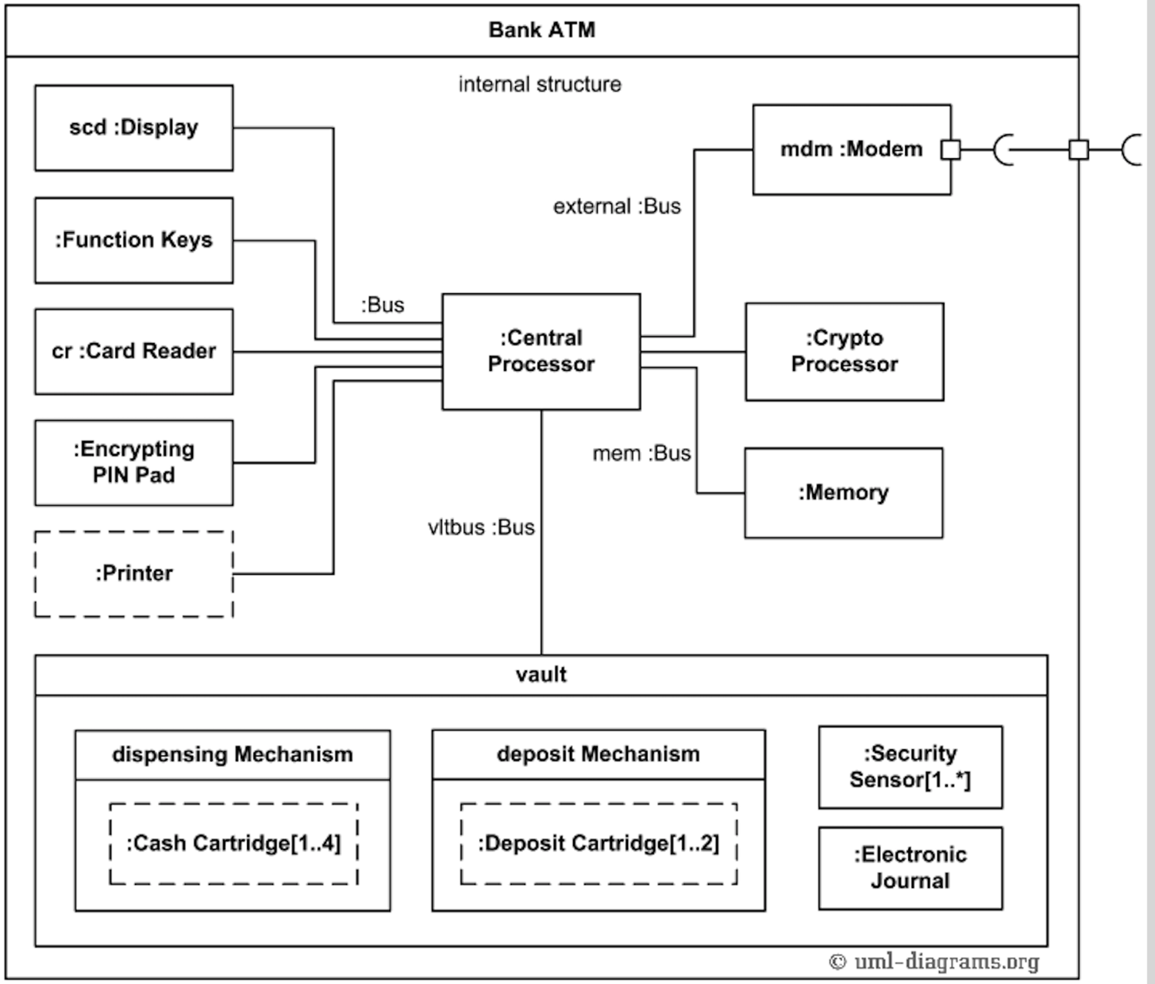



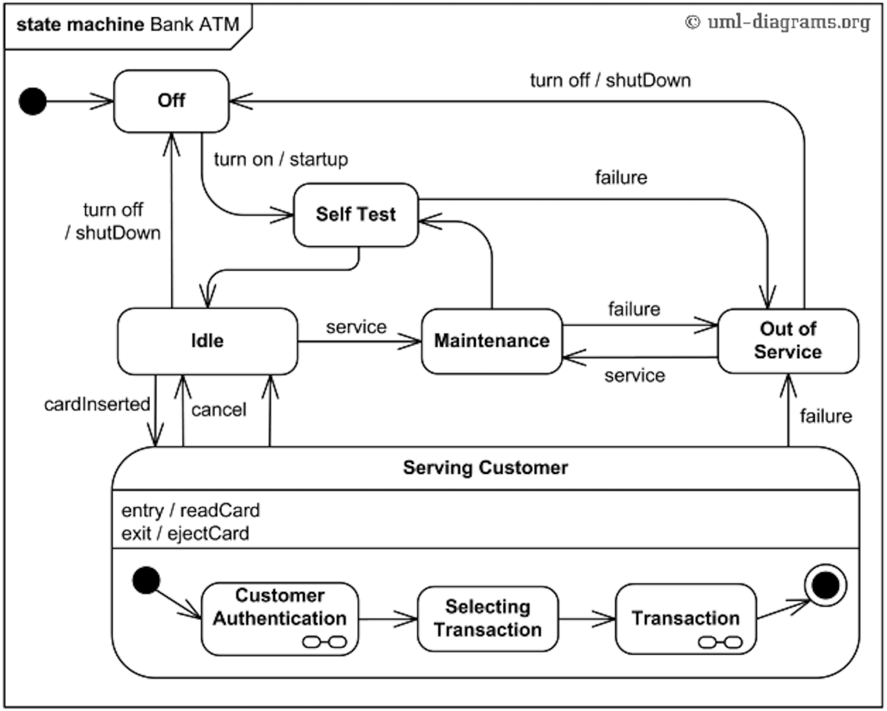





General Design Process
A common method is to create multiple designs and perform comparative evaluation.
Business goals
Traceability
Requirements
Software Architecture Design
Evaluation and Decision Making
Implementation
Architectural constraints
Refine
Ideas
Notes:
What is design process from architecture perspective.
Software design is a creative process, which includes proposing and evaluating solutions to complex problems with many conflicting constraints.
The final design of a software system after iterations is the result of many design choices about the selection, configuration, and integration of software, hardware, and communications components.

Slide 13
Recap: Non-Functional Properties and Requirements
Requirements: what needs should your system fulfil?
Properties: what are the characteristics of your system?
There are two kinds of requirements:
Functional Requirements (i.e. what are the inputs and outputs)
Non-Functional Requirements (a.k.a. Qualities, or -illities)
e.g. “Performance” (latency, throughput, … )
e.g. “Security” (confidentiality, integrity, availability, privacy, …)
e.g. Usability, Reliability, Modifiability, …
Cost
Technical and business constraints
Notes:
Two kinds of requirements
FR: specify the behavior of system
NFR: specifies criteria that can be used to judge how well the system operates
With a fixed budget and timeframe, there is tradeoffs between non functional properties

Slide 14
Recap – Simplified View: Non-Functional Trade-Offs
Compared to conventional database & script engines, blockchains have:
(-) Confidentiality, Privacy
(+) Integrity, Non-repudiation
(+ read/ - write) Availability
(-) Modifiability
(-) Throughput / Scalability / Big Data
(+ read/ - write) Latency

Slide 15
Architecture Analysis Methods
Analysis is one of the important uses of models
e.g. does this design support service availability?
(Quantitative) fault-tree statistical analysis
(Qualitative) failure scenarios
e.g. What is the transaction latency in this design?
(Quantitative) Simulation-based prediction of latency distributions
(Quantitative) Formula-based calculation of average latency
e.g. Will this design ensure confidentiality?
e.g. Is this design easily modifiable?
Different kinds of models allow different kinds of analyses

Slide 16
Design Trade-offs
Often, improving one quality will hurt another one
e.g. Use a bigger server
faster, but more expensive
e.g. Use redundant servers
better availability (hot fail-over)? Or better performance (load balancing)? Worse write latency? More expensive
What are the trade-offs? How should you choose?
Specific methods exist to help
ATAM: Architecture Trade-off Analysis Method
Multi-criteria decision-making methods
Goal: determine if the architecture can achieve the NFRs before developing a system (which is typically a big investment)

Slide 17
ATAM: Architecture Trade-off Analysis Method – Steps in the Method:
Presentation
Present ATAM to stakeholders
Present Business Drivers (NFRs and business goals)
Present Current Architecture
Investigation & Analysis
Identify Architectural Approaches
Generate Quality Attribute Utility Tree (& initial use case scenarios)
Analyse Architectural Approaches (for high-priority factors from step 5)
Brainstorm & Prioritise Scenarios
Analyse Architectural Approaches (using scenarios as test cases)
Reporting
Present Results (summary, risks, sensitivities/trade-offs, …)

Slide 18
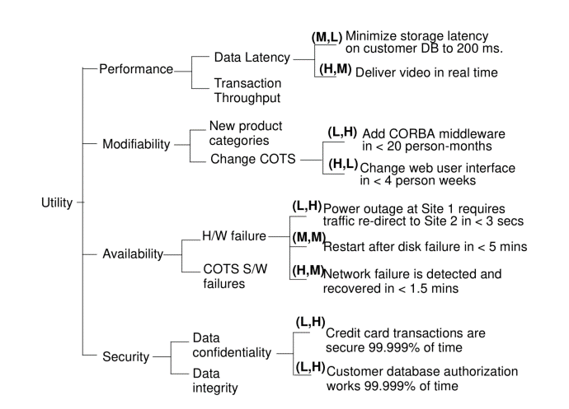
ATAM Quality Attribute Utility Tree
Legend:
(Importance, Risk to Achieve)
Utility trees make system goals more specific and more concrete
Allows understanding relative importance of NFRs → deciding on priority
Example from “ATAM: Method for Architecture Evaluation” (Kazman et al., 2000)
https://resources.sei.cmu.edu/asset_files/TechnicalReport/2000_005_001_13706.pdf

Slide 19
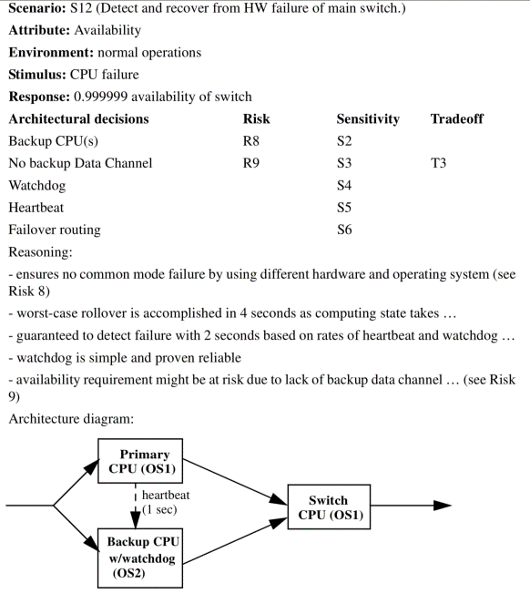
ATAM Scenarios
Scenarios are commonly used in Software Architecture
In ATAM, links attributes, risks, trade-offs, & reasoning about architecture design
Qualitative – identify and evaluate risks
Methodical, but not exhaustive
In ATAM, stakeholders vote on importance of scenarios
Example from “ATAM: Method for Architecture Evaluation” (Kazman et al., 2000)
https://resources.sei.cmu.edu/asset_files/TechnicalReport/2000_005_001_13706.pdf

Slide 20
Design Process for Blockchain-based Systems
Notes:
We discuss an indicative model for the design of systems that might use blockchain technology.

Slide 21
Design Process
Every step is a procedure to decide between alternative options
Taxonomy in Lectures 7 & 8
Systematic comparison of different design options
Notes:
The available options discussed in Lecture 3are used to assist decision-making and to guide the system design at different stages of the design process.
This enables a systematic comparison of the capabilities of different design options.

Slide 22
Trade-off Analysis 1/2
Quality | Design decision
Scalability | Blockchain tech platform, block size, block frequency
Security | Consensus protocol
Cost efficiency | Public/Consortium/Private blockchain
Performance | Data structure
Design decision impact
A decision may improve the performance of one quality attribute
…but may harm the performance of other quality attributes
Notes:
There are trade-offs between quality attributes in the design of blockchain-based systems.
Some decisions mainly affect scalability (like block size and frequency),
security (like consensus protocol),
cost efficiency (like type of blockchain) or
performance (like data structure).
Design decisions that improve the performance of one quality attribute for a system may harm the performance of other quality attributes. Some simple examples of this include:

Slide 23
Trade-off Analysis 2/2
Encrypting data before storing it on a blockchain
Increase confidentiality
Reduce performance, may harm transparency or independent auditability
Storing only a hash of data on-chain and keeping the contents off-chain
Improve confidentiality and performance
Partly undermine the benefit of blockchains in providing distributed trust
May introduce a single point of failure, thus reducing system availability and reliability
Using private blockchain instead of public blockchain
Allow greater control over the admittance of processing nodes and transaction into the system
Increase barriers to entry for participation, thus partly reduce some benefit of using blockchain
Higher number of confirmation blocks
Increase confidence in integrity and durability of transaction
Harm latency
Notes:
For blockchains that use Nakamoto consensus such as Bitcoin or Ethereum,
waiting for a higher number of confirmation blocks may increase confidence in integrity and durability of transactions,
but will harm latency and thus may impact service availability.

Slide 24



Student Task
Consider the case of exam registration, as before
Take 1 minute to think about the previous four aspects in this context
Take notes
Then we’ll discuss

Slide 25
Decentralization
Blockchain is used in scenarios…
…where no single trusted authority is required
…where the trusted authorities can be decentralized or partially decentralized
Spectrum: deployment and operation of a system
Some components or functions are decentralized while others are centralized
Centralized monopolies
Central parties with competition between parties
Services provided jointly by consortium
Fully open service provision in a peer-to-peer system
Notes:
Look at the design process again
After evaluating the suitability of using blockchain, the next step is to decentralize the trusted authority if there is any
For the deployment and operation of systems, there is a spectrum of options ranging from centralised monopolies, to central parties with a competition between parties, to services provided jointly by a consortia, through to fully open service provision in a public peer-to-peer system.
It is possible that some components or functions are decentralised while others are centralised.

Slide 26
On-chain vs. Off-chain
On-chain
User interface
Cryptographic key management
IoT integration
Communication with external systems
Many kinds of data are better stored off-chain
Scalability reason—“Big” data
“Non-tiny” data may be too large to store on blockchain
Confidentiality reason – private data
Dealing with legacy database
Notes:
Blockchains are usually combined with other components in a broader system.
Next step is to decide what is on and off blockchain depends on the characteristics of data and computation
While blockchains provide some unique properties, the amount of computational power and data storage space available on a blockchain network remains limited.
the monetary cost of using public blockchains follows a different cost model than conventional software systems.
In regards to cost efficiency, performance, and flexibility, major design decisions in using a blockchain include choosing what data and computation should be placed on-chain and what should be kept off-chain.
Functionality such as user interfaces, cryptographic key management, IoT integration, and communications with other external systems is inherently off-chain.
Cost calculations can help to determine the resolution of design decisions for this issue.

Slide 27
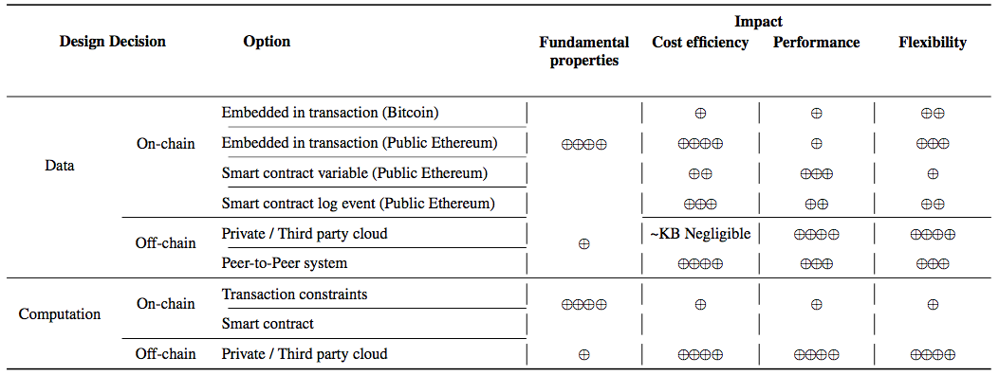
Design Decisions and Their Impact
Notes:
Overview on design decision regarding on-chain and off-chain and their impact

Slide 28

On-chain Data
Colored coin as On-chain auxiliary data
Overlays on Bitcoin to represent real world assets
Common practices of storing item data
Raw data off-chain
On-chain just meta-data, small critical data and hashes of the raw data
On-chain data not just for integration with external data
Store data in Bitcoin
OP_RETURN (limited to 40 bytes)
Slow and costly
Store data in Ethereum
Storing arbitrary data in transaction
Transaction size is limited by the maximum size of a block
Practically smaller transactions accepted by other users
Storing data in smart contract
As variable in a smart contract
As a log event of a smart contract
Variable is more efficient to manipulate, but less flexible due to the constraints of language
Notes:
The applications of storing item data on blockchain are not just for integration with external data.
There are various uses for wholly on-chain auxiliary data, including e.g. “coloured coins” which are a class of overlays on Bitcoin to represent and manage real world assets.
In the Bitcoin blockchain, the special OP_RETURN is introduced to add arbitrary data into a bitcoin transaction.
Storing data on the Bitcoin blockchain is slow and costly, and limited to 40 bytes.
the size of a transaction is limited by the maximum size of a block,
and in practice transactions typically need to be smaller to be accepted due to the transaction load from other users.

Slide 29
Cost Model
Monetary cost of using public blockchains follows a different cost model than conventional software systems
More expensive
One-time cost for permanent storage
Partial refund of Ethereum for deleting
Notes:
Data storage on blockchain follows a different cost model than conventional data storage.

Slide 30


Off-chain Data Storage
Concern the interaction between blockchain and data storage facilities
Cloud storage
Private cloud on the client’s infrastructure
Public storage provided by a third party
Data replication is managed by the system or consumer
Peer-to-peer data storage
IPFS (InterPlanetary File System)
Free, but availability depends on IPFS server that hosts the data
StorJ
Data is replicated automatically, or based on the user behavior
Notes:
Selection of off-chain data storage concerns the interaction between the blockchain and the conventional data storage facilities.
Off-chain data storage can be through conventional enterprise IT systems
The flexibility of using cloud to store data depends on the implementation.
In a cloud environment, data replication needs to be managed by the system or consumer.
Some peer-to-peer data storage facilities are designed to be friendly to blockchain, such as IPFS and Storj. In a peer-to-peer data storage
e.g., data is replicated once a user accesses it.

Slide 31
Student Task
Consider the case of exam registration, as before
For half a minute, think about off-chain data storage in this context: where would it be applicable?
Take notes
Then we’ll discuss

Slide 32
Design Decisions and Their Impact

Slide 33

Computation
Different levels of expressiveness of on-chain computation
Bitcoin only allows simple scripts and conditions
To transfer Bitcoin payment, script must result in “true”
Ethereum provides a Turing complete programming language
Scope extends far beyond conditional payments
Make modification to the working data in smart contract variables
DAML (Digital Asset Modelling Language)
More expressive than Bitcoin Script
Purposefully not Turing-complete: codify financial rights and obligations
Allows static analysis
Non-determinism (in practice)
Code is deterministic, but:
Blocks impose an order on transactions, by default not controlled
Resulting non-determinism might affect the execution results
Benefit of on-chain computation
Inherent interoperability among the systems built on the same blockchain network
Neutrality of execution environment
Immutability of the program code once deployed
Notes:
Computation in a blockchain-based system can be performed on-chain (e.g., through smart contracts) or off-chain.
Smart contracts are not processed until their invoking transactions are included in a new block.
Blocks impose an order on transactions, thus resolving non-determinism which might otherwise affect their execution results
This facilitates building trust in the shared code among untrusting parties.

Slide 34
Impact of Other Components
Other components in the broader system have impact on design decisions
What’s on-chain vs. what’s off-chain
Identity management (One of the example use cases)
Supports systems where is a requirement to know individual human or system involved in transactions
International payments have regulatory requirement to establish identity of participants
AML (Anti-Money Laundering) and CTF (Counter-Terrorism Financing)
Real-world identity is not required from technical perspective
Bitcoin transacting agents are only cryptographically identified
International exchange can be performed without establishing real-world identity
AML/CTF requirements are not obviated by the use of blockchain
Off-chain protocol might be used to store identity information
Privacy and confidentiality can be a challenge when storing on-chain
Notes:
Deciding between on-chain and off-chain not only depends on trade-offs among quality attributes
but also on how information and computation is used by other components in the broader system.
Identity supports systems where there is a requirement to know the individual human or system involved in transactions.
Services such as international payments have regulatory requirements to establish the identity of participants, as part of Anti-Money Laundering (AML) and Counter-Terrorism Financing (CTF) policies.
From a purely technical perspective, real-world identities are not necessarily required.
For example on Bitcoin, transacting agents (which are not necessarily persons) are only cryptographically identified, pseudonymously.
So international exchange of the Bitcoin digital currency can be performed without establishing real- world identity.
Nonetheless, AML/CTF requirements are not obviated by the use of a blockchain.
Identity is critical here, and identity on blockchain is sometimes considered to be a key enabler for many financial services on blockchain.
However identity information does not necessarily need to be stored on-chain, off-chain protocols might be used instead.
Privacy and confidentiality can be a challenge when integrating identity information into a blockchain-based system.

Slide 35
Student Task
Consider the case of exam registration, as before
Take 1 minute to think about which parts of the computation to perform on-chain and which parts off-chain
Take notes
Then we’ll discuss

Slide 36
Blockchain Selection
For blockchain platform selection, consider
Requirements of the use case
Characteristics of blockchain platform
Trade-off analysis
Consensus protocol and other decisions are typically fixed once blockchain is selected
Hyperledger Fabric is an exception
Supports pluggable implementations of various consensus protocols
Inter-block time is configurable for many consensus protocols
For Proof-of-Work: through adjustments to the difficulty of mining, with difficulty adaptation disabled
Notes:
The next step is to select and configure blockchain

Slide 37
Deployment
Deployment has impact on quality attributes
Deploying on cloud or using BaaS (Blockchain-as-a-Service)
Introduces uncertainty of cloud infrastructure
If all nodes use the same cloud provider, it becomes a trusted third-party and a single point of failure
Deploying a public blockchain on a VPN (virtual private network)
Becomes a private blockchain
Permissioned access controls provided at the network level
VPN introduces additional network latency overhead
Notes:
The last step is deployment and operation
the choice of where to deploy the modules of the blockchain-based system is also important for the quality attributes of blockchain-based systems.

Slide 38
Student Task
Consider the case of exam registration, as before
But imagine we use one system for all universities in Germany
Take half a minute to think about where to deploy a blockchain for this context
Take notes
Then we’ll discuss

Slide 39
Operation
Operation challenges
Blockchain-based systems can be harder to modify than conventional systems
Blockchain platform software running on multiple independently-operating nodes
Updating software can by physically and administratively difficult to coordinate
Blockchain is immutable by design, so cannot be retrospectively updated
Trust is derived partly from the fact that the smart contract cannot be changed easily
Governance
Changes may be made to correct defects, add features or migrate to new IT context
More like diplomacy in multi-party system with no single owner
Blockchain is NOT SUITABLE to a system that needs to change frequently
Learn from governance in open-source software
Governance concerns software development, deployment and operation
Immutable smart contract also simplify governance to some degree
Smart contract is available for execution while the blockchain operates normally
Notes:
There are specific design challenges related to the operation of blockchain-based systems
The blockchain ledger is immutable by design, and so cannot be retrospectively updated to facilitate system modification.
In blockchain-based systems that use smart contracts to regulate interactions between mutually-untrusting parties, trust is derived partly from the fact that the code cannot be changed easily.
This inherently creates challenges for governance: the management of the evolution of blockchain-based systems.
However, in a multi-party system with no single owner, managing these changes is more like diplomacy than traditional risk management or conventional product management.
Lessons may be drawn from governance in open-source software, which face similar development challenges.
For both public and private blockchain systems, key stake- holders include the users of the blockchain, software developers, miners or processing nodes in the blockchain ecosystem, and government regulators in related industries.
However, blockchain immutability may also simplify governance oversight to some degree.
Smart contracts deployed on a blockchain will be resistant to tampering, and will continue to be individually available for execution while the whole blockchain operates normally.
These factors should be taken into consideration when deciding to use blockchain as a component.

Slide 40
Summary
Suitability needs to be evaluated first
Fundamental properties and limitations of blockchain
Each step of the design process: design decision(s)
On-chain vs. off-chain
Subsidiary design decisions
Notes:
For a system that can potentially use blockchain, the first design choice is to decide whether to use a blockchain or conventional technologies.
We discuss this choice in section of suitability evaluation and give four examples.
Often in a blockchain-based system, some data is stored on the blockchain while other data is stored and communicated using conventional technologies, so another design choice is which data should be stored where.
When using a blockchain, there are subsidiary design choices including whether to use a private blockchain or a public blockchain, what consensus protocol is best, and what the block frequency should be

Slide 41
Design Process
Source of most materials:
Xiwei Xu, Ingo Weber, and Mark Staples. Architecture for Blockchain Applications. Springer, 2019

